Slide 1

Faculty of Applied Engineering and Urban Planning
Civil Engineering Department
Dr. Eng. Mustafa Maher Al-tayeb
2 Semester 2022/2023
Probabilistic and Statistical

Slide 2
Chapter 4
Probability
and
Counting
Rules
2

Slide 3
4-1
4-2
4-3
4-4
Overview
Fundamentals
Addition Rule for Probability
Multiplication Rule: Complements
and
Conditional
Probability
4-5 Probability
and Counting Rules
3

Slide 4
Overview
 Probabilities is
likelihood of an
a
mathematical measure
of
the
event occurring.
 Probabilities
are
always
fractions
or
the
decimals
time that
indicating the portion or percent of
the event occurs
4

Slide 5
Fundamentals
5

Slide 6
Probabilistic and Statistical Techniques
Probabilistic and Statistical Techniques
An Experiment and Its Sample Space
An experiment is any process that generates
well-defined outcomes.
The sample space for an experiment is the set of
all experimental outcomes.
An experimental outcome is also called a sample
point.
Event is any collection of results or outcomes of
a procedure

Slide 7
Experiment
and
Experiment Outcomes
Experiment
Experiment Outcomes
Toss a coin
Roll a die
Play a football
Head, Tail
1,2,3,4,5,6
Win, Lose, Tie
game
7

Slide 8

Rolling
a
Die
• The sample space of the experiment of rolling a die
has 6 possible outcomes 1-6, so:
S = {1, 2,3, 4,5,6}
• The Event : Rolling an even number
is an event
for
the
experiment
of
rolling
a
die.
If
we
call
this
event E, we could write:
E = {2, 4,6}
8

Slide 9
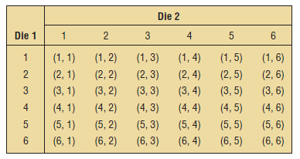

Ex. Find
the
sample
space
for
rolling
two
dice.
Solution
:
9

Slide 10
Notation for Probabilities
denotes a probability.
P :
A, B, and C :denote specific events.
P (A) :denotes the probability of event
A occurring.
10

Slide 11
Assigning Probabilities
Two approaches to assigning probabilities will be
namely the objective and subjective viewpoints.
discussed,
Objective Probability is subdivided
into
:
1)
2)
Classical probability .
Empirical probability.
11

Slide 12



Assigning Probabilities
Classical Method
Assigning probabilities based on the assumption
of equally likely outcomes
Empirical Method Or Relative Frequency Method
Assigning probabilities based
or historical data
on
experimentation
Subjective Method
Assigning probabilities based
on
judgment
12

Slide 13
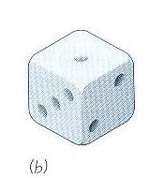
Probabilistic and Statistical Techniques
Basic Rules for Computing Probability
Rule 1: Probability for Equally likely outcomes (classical)
Assume that a given procedure has n different simple events and each of those simple events has an equal chance of occurring. If event A can occur in s of these n ways, then
s
number of ways A can occur
P(A) =
=
n
number of different simple events

Slide 14
Probabilistic and Statistical Techniques
Rule 1: Example
Consider an experiment of rolling a die. What is the probability of the event (an even no. appears)?
s
3
P(A) =
=
= 0.5
n
6

Slide 15
Probabilistic and Statistical Techniques
Rule 2: Relative Frequency (empirical)
Observe results , and count the number of times event A actually occurs. Based on these actual results, P(A) is estimated as follows:
number of times A occurred
P(A) =
number of times trial was repeated

Slide 16
Probabilistic and Statistical Techniques
Rule 2: Example
On February 1, 2003, the space shuttle Columbia exploded. This was the second disaster in 113 space missions for NASA. On the basis of this information, what is the probability that a future mission is successfully completed?
number of successful flights
P(A) =
Total number of flights
= 111/113 = 0.98

Slide 17

Probabilistic and Statistical Techniques
Rule 3: Subjective Probabilities
If there is little or no past experience or information on which to base a probability, it may be arrived at subjectively, this means an individual evaluates the available opinions and other information and then estimates the probability.

Slide 18
Probabilistic and Statistical Techniques
Rule 3: Example
Estimation the probability General Motors Corp. will lose its number 1 ranking in total units sold to Ford Motors Co. within 2 years
Estimating the likelihood you will earn an A in this course.

Slide 19
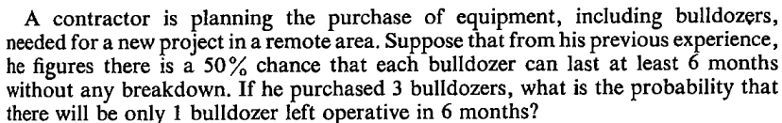

Example

Slide 20
Solution
Events: GGG, GGB, GBB, BBB, BBG, BGG, BGB,GBG
Events having one bulldozer good: GBB,
BGB,BBG
Total number of events = 8
Number of events
with one
G= 3
Probability of one G = 3/8

Slide 21
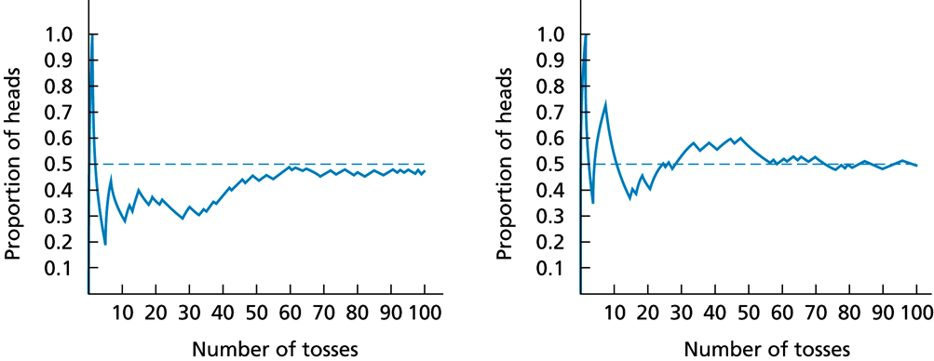
Probabilistic and Statistical Techniques
Law of Large Numbers
As a procedure is repeated again and again, the relative frequency probability (from Rule 2) of an event tends to approach the actual probability.

Slide 22
Probability Limits
Probabilistic and Statistical Techniques
The probability of an impossible event is 0.
The probability of an event that is certain to occur is 1.
For any event A,
the probability of A is between 0 and 1 inclusive.
That is, 0 ≤ P(A) ≤ 1.

Slide 23
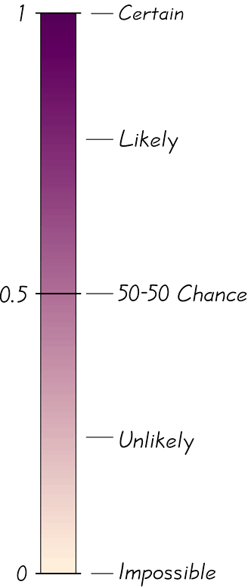
Possible Values for Probabilities
Probabilistic and Statistical Techniques

Slide 24
Probabilistic and Statistical Techniques
Example 1
In a class , 18 students own computers and 7 do not. If one of the student is randomly selected, find the probability of getting one who does not own a computer

Slide 25
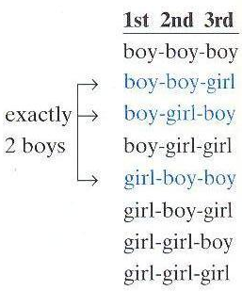
Probabilistic and Statistical Techniques
Example 2
Find the probability that a couple with 3 children will have exactly 2 boys.

Slide 26

Probabilistic and Statistical Techniques
Example 3
When two balanced dice are rolled, 36 equally likely outcomes are possible:
a) find The probability the sum is 11, b) the two dice are doubles
The sum of the dice can be 11 in two ways. The probability the sum is 11 = 2/36 = 0.056.
Doubles can be rolled in six ways. The probability of doubles = 6/36 = 0.167.
Notes:
26
Change to page 154

Slide 27
Probabilistic and Statistical Techniques
Definition
The complement of event A, denoted by , consists of all outcomes in which the event A does not occur.

Slide 28
Probabilistic and Statistical Techniques
Example 4
The General motor co. wanted to test a new model. 50 drivers has been recruited, 20 of whom are men. When the first person is selected , what the probability of not getting a male driver?

Slide 29
Probabilistic and Statistical Techniques
Addition Rule

Slide 30
Probabilistic and Statistical Techniques
Key Concept
The main objective of this section is to present the addition rule as a device for finding probabilities that can be expressed as P(A or B), the probability that either event A occurs or event B occurs (or they both occur) as the single outcome of the procedure.

Slide 31
Probabilistic and Statistical Techniques
When finding the probability that event A occurs or event B occurs,
find the total number of ways A can occur and the number of ways B can occur, then find the total in such a way that no outcome is counted more than once.
Notation
P(A or B) = P (in a single trial, event A occurs or event B occurs or they both occur)

Slide 32
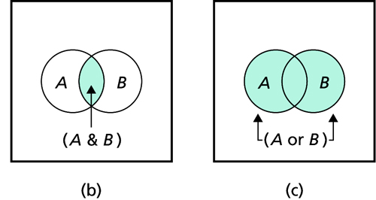
Probabilistic and Statistical Techniques
Addition Rule
Formal Addition Rule
P(A or B) = P(A) + P(B) – P(A & B)
where P(A and B) denotes the probability that A and B both occur at the same time as an outcome in a trial or procedure.

Slide 33
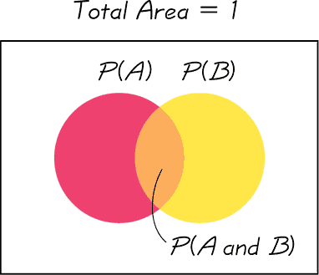
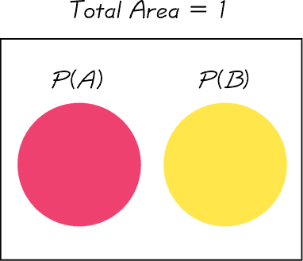
Definition
Probabilistic and Statistical Techniques
Events A and B are disjoint if they cannot occur at the same time. (That is, disjoint events do not overlap.)
Events That Are Not Disjoint
Disjoint Events

Slide 34
Complementary Events
Probabilistic and Statistical Techniques
P(A) and P(A)
are disjoint
It is impossible for an event and its complement to occur at the same time.

Slide 35
Rules of Complementary Events
Probabilistic and Statistical Techniques

Slide 36
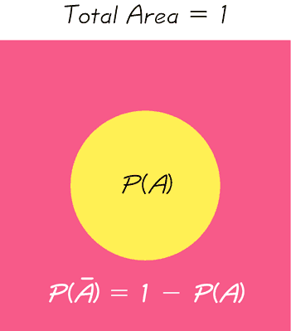
Venn Diagram for the Complement of Event A
Probabilistic and Statistical Techniques
If P(A) = 0.3
P(A) = 1 – P(A) = 1 – 0.3 = 0.7

Slide 37
Addition
Rules
for
Probability

Slide 38
Key Concept
The main objective of this section is to present the
addition rule as a device for finding probabilities
that can be
that either
expressed as P(A or B), the probability
event
occur)
A
occurs
or
event
B
occurs
(or
the
they
both
as
the
single
outcome
of
procedure.

Slide 39
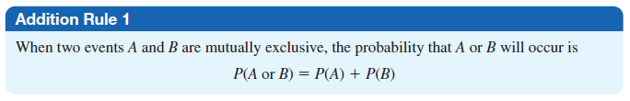
Ex. A city has 9 coffee shops: 3 Starbucks, 2 Caribou Coffees, and 4
Crazy
a cup
Crazy
Mocho Coffees. If a person selects one shop at random to buy
of coffee, find the probability that it is either a Starbucks
Mocho Coffees.
or
Solution :
P(Starbucks or Crazy Mocho) = P(Starbucks) + P(Crazy Mocho)
= (3/9) + (4/9) = 0.778
The events are mutually exclusive.

Slide 40
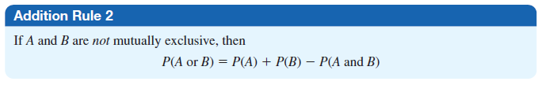
When finding
B occurs, find
the probability that event A occurs or event
the total number of ways A can occur and
the number of
such a way that
ways B can occur, then find the total
in
no outcome is counted
more than once.
Notation
P(A or B)
= P
(in a single trial, event
A occurs or event
B
occurs or they both occur)

Slide 41
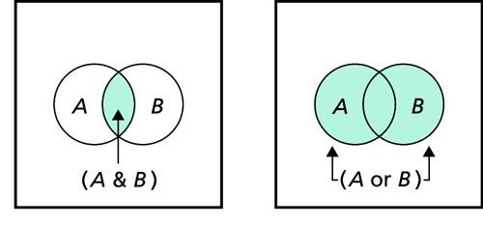
Addition Rule
Formal Addition Rule
P(A or B) = P(A) + P(B) – P(A & B)
where P(A and B) denotes the probability that A and B
at the same time as an outcome in a trial or procedure.
both
occur
P(A ∪ B)
=
P(A)+ P(B) − P(A ∩ B)

Slide 42



Definition
Events A and B are disjoint events if they cannot occur at
the
same
time.
(That
is,
disjoint
events
do
not
overlap.)
Events
That Are Not Disjoint
Disjoint Events

Slide 43

Complementary
Events
P(A)
and
P(A)
are
disjoint
It
to
i impossible for
occur at the same
an event
time.
and
its
complement

Slide 44
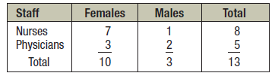

Ex. In a hospital unit there are 8 nurses and 5 physicians;
7 nurses and
selected, find male.
3 physicians are females. If a
staff person is
the
probability
that
the
subject
is
a
nurse
or
a
Solution:

Slide 45





Operational
rules
Note: AB
= A ∩ B

Slide 46





Operational
rules

Slide 47
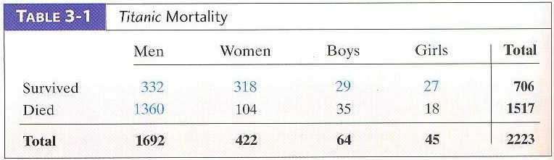
Probabilistic and Statistical Techniques
Example 5
Titanic Passengers (Table 3-1), Assuming that 1 person is randomly selected from 2223 people abroad the titanic:
Find P (selected a man or a boy)
Find P (selected a man or some one who survived)

Slide 48
Probabilistic and Statistical Techniques
Solution
P (selected a man or a boy) = P (men) + P (boys) =
P (selected a man or survived)
= P (men) + P (survived) – P (men & survived) =

